Slide 1

2020
Nantong Xushi Group
——We Focus on High-end Plenum Cables

Slide 2
01.About Us
02.Product & Service
CONTENTS
03.Oversea Strategy
04.Contact Us

Slide 3
01
PART ONE
About Us

Slide 4
1. About Us
1.1
Company Profile
1.2
History
1.2
1.3
1.3
Production Facilities &Capacity
1.4
1.4
Advantages
1.1
1.5
1.5
Certificates

Slide 5
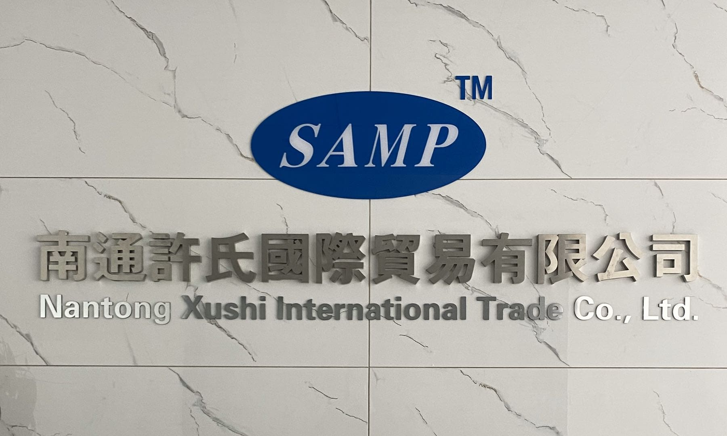
1.1 Company Profile
Nantong Xushi Group
China's foremost manufacturer of flouropolymer communication cables.
We focus on plenum rate communication cables for US and Canada High-end Market.
With our technologies, we are fighting for the mission of improving “Made in China” to “Created in China” for creating value for our worldwide customers, suppliers and our employees.

Slide 6
1.1 Company Profile
GOAL
Philosophy
Technologies
Continually develop leading edge flouropolymer technologies to maintain us and our partner as the leading solution provider in low voltage communication cable industry.
The Key to success is focus.
We focus on plenum rate communication cables for US and Canada market more than 10 years.
We developed SAMP physical foam FEP by Nano-Technology in 2008 and chemical foam FEP in 2016 then developed Skin-Foam FEP technology in 2018.

Slide 7
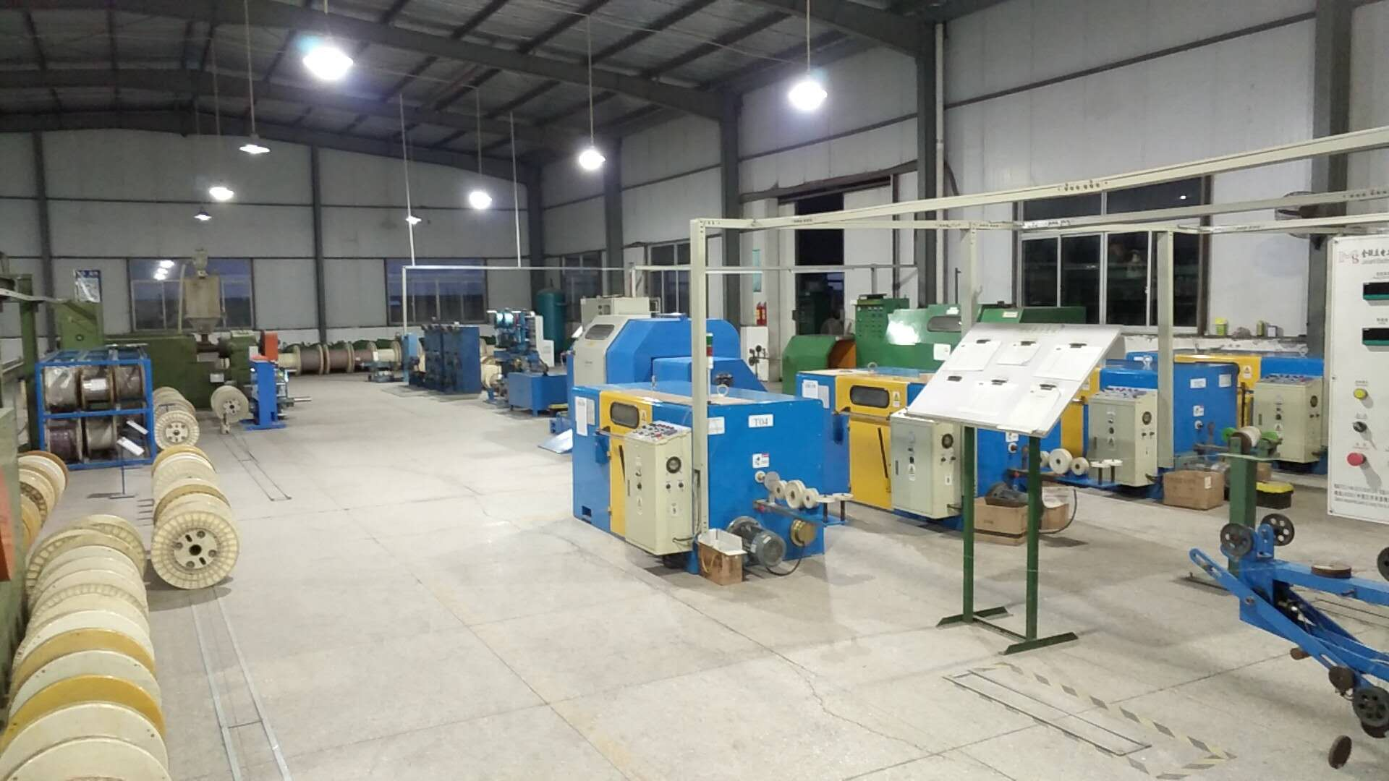
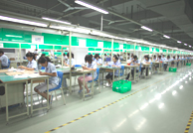
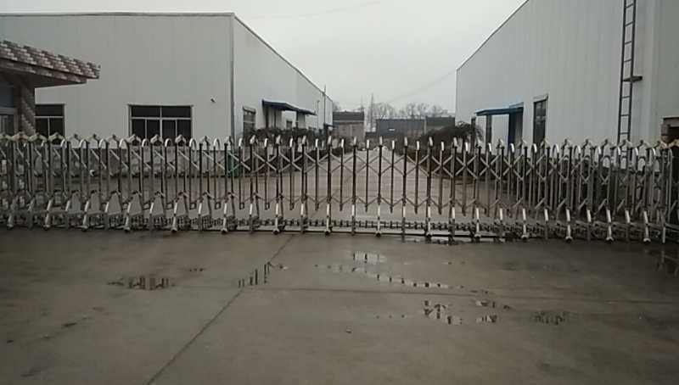
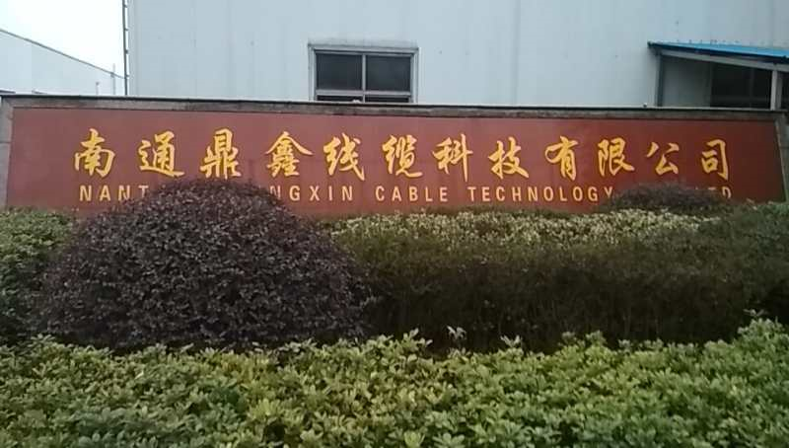
1.2 History
The first China company acquire CMP grade UL certifications for communication cables.
Improved FEP foaming technology, start to produce RG series coaxial cable in skin-foam type.
Dingxin Group registered capital 10 million RMB, mainly produce low voltage communication cables.
1997
2003
2009
2016
2018
Dingxin moved to Rugao Jiang'an industry park for capacity expansion and And acquired ISO9001certification, and start to do international trade.
Set up Suzhou Fuchen for plenum patch cord and
produce chemical foam FEP cabes for Lutron Lighting control systems.

Slide 8
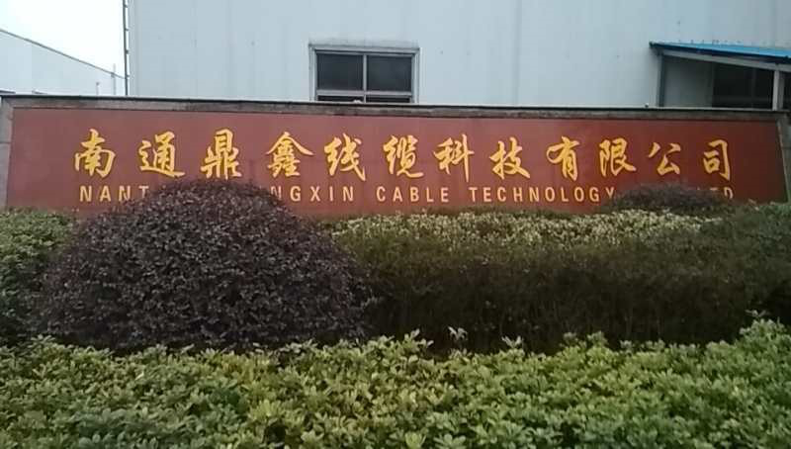
1.3 Production Facilities & Capacity
Nantong Xushi Group attaches two factories to provide cable production
Nantong Xushi Group
Nantong Dingxin Cable
Technology Co.,Ltd .
A
B
Suzhou Fuchen Electric
Material Co.,Ltd

Slide 9
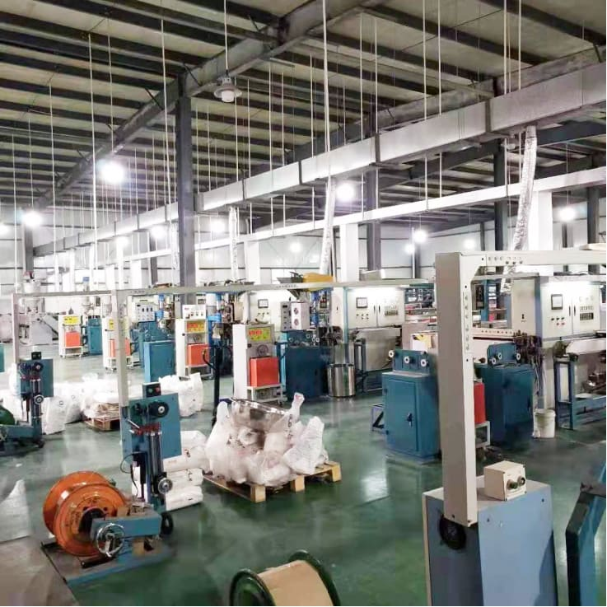
1.3 Production Facilities & Capacity
Main facilities for plenum FEP cables:
1. We have 2 production lines for plenum physical foam FEP coax cable
2. We have 1 production line for chemical foam FEP cable
3. 12 production lines for high temperature solid FEP cable
Capacity for plenum Coax cables:
Roughly 120000KFT，8 40’HC, per month for plenum foam FEP coax cable.
We currently use roughly 30% our capacity.

Slide 10
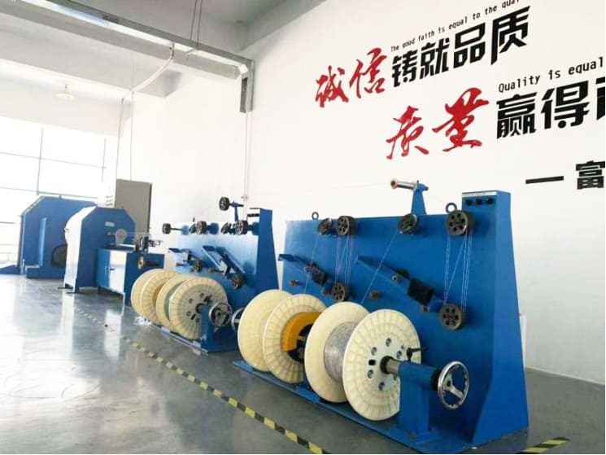
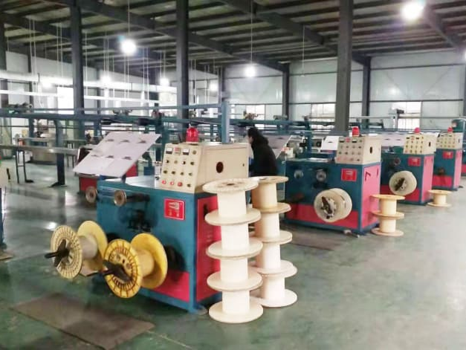
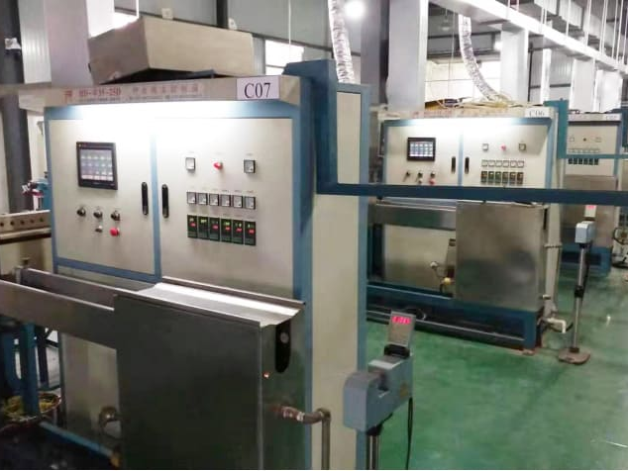
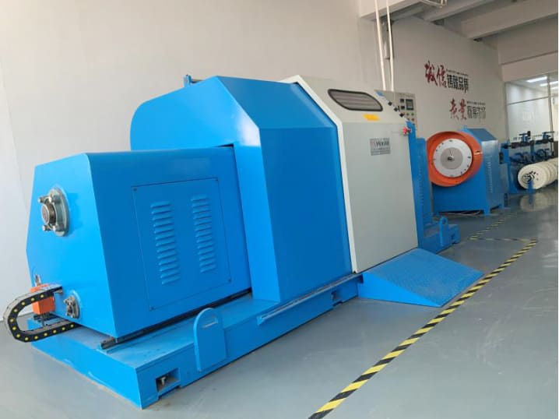
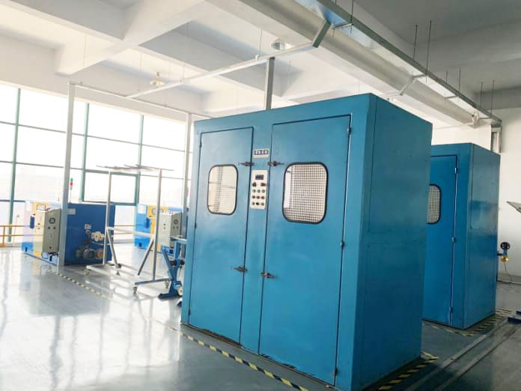
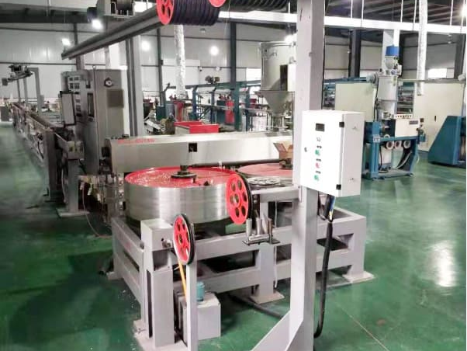
1.3 Production Facilities & Capacity

Slide 11



1.4 Advantages
1
2
20+
Focus on 1 market and on 1 series of cable.
Rapid response in 1 day.
2 main technologies. Physical & chemical foam or Skin-foam FEP technology and FEP Spline technology
More than 20 years of professional communication manufacturing experience

Slide 12
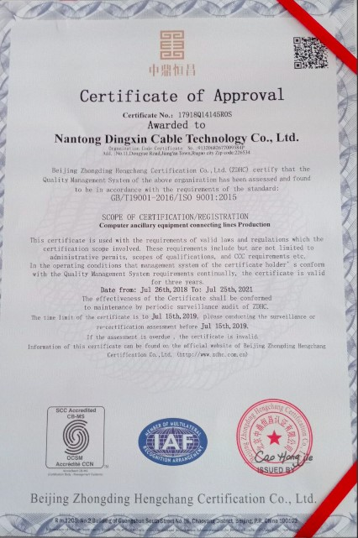
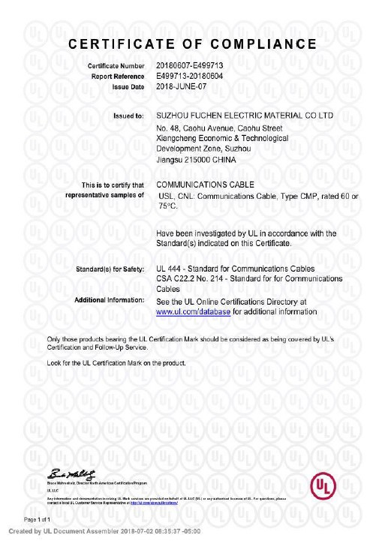
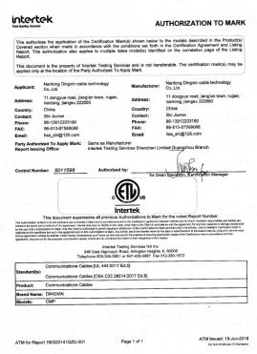
1.5 Certificates
We have passed the ISO 9001,UL,ETL certifications

Slide 13
02
Product & Service
PART TWO

Slide 14
2. Product & Service
2.1 Flouropolymer Communication cable
2.2 Integrated Wiring
Products
Service

Slide 15
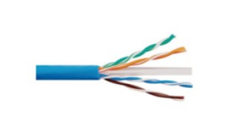
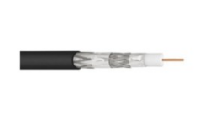
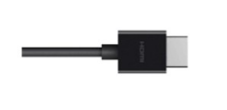
2.1 Flouropolymer Communication cable
I
Plenum Networking Cable
CAT5E, CAT6, CAT6A ,CAT7
UTP - FTP -STP - SFTP Available
FEP or Flame Retardant LSZH Spline Available
Plenum Coaxial Cable
II
RG59,RG6,RG11,RG59 With 2-18 AWG
Solid Bare Copper or Copper Clad Steel Conductor
Foaming FEP or SKIN-FOAM FEP Instion For High-end Available
Plenum HDMI Cable
III
24AWG or 26 AWG Construction For Low Loss/Zero Bit Erro Signals
Supports Up To 2.25 Gbps /1080p And 10.2 Gbps 2K *4 K
Custom Lengths Available
Type-A Gold Plated Connectors With Ethernet

Slide 16
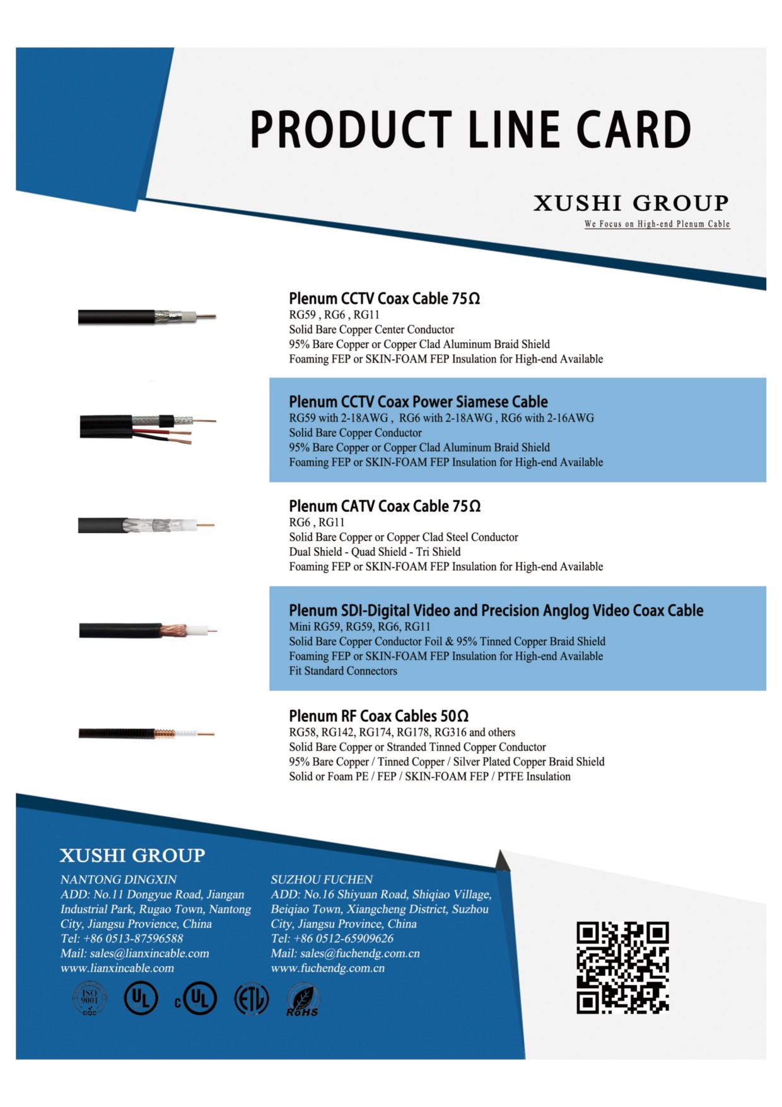

2.1 Flouropolymer Communication cable

Slide 17
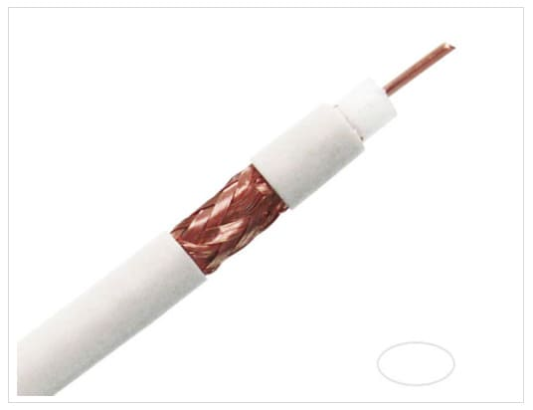
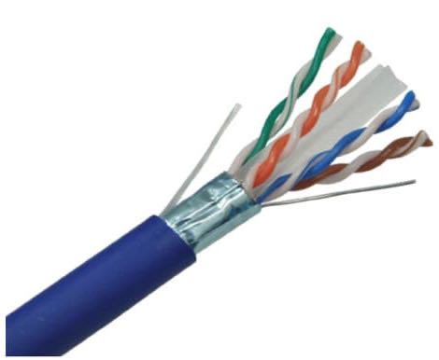
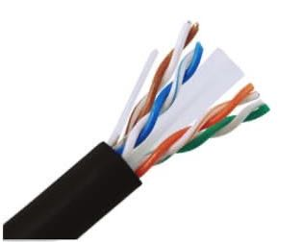
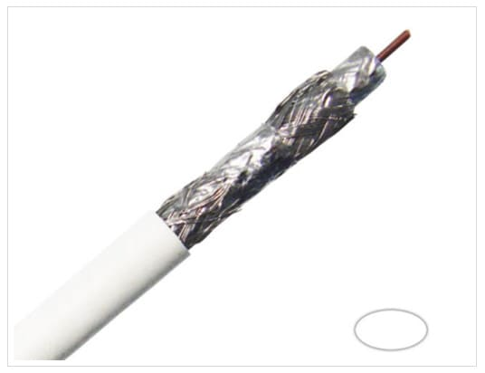
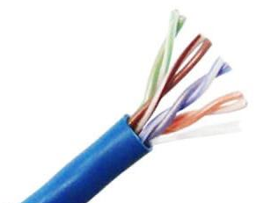
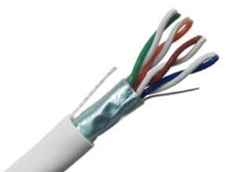
2.1 Flouropolymer Communication cable

Slide 18
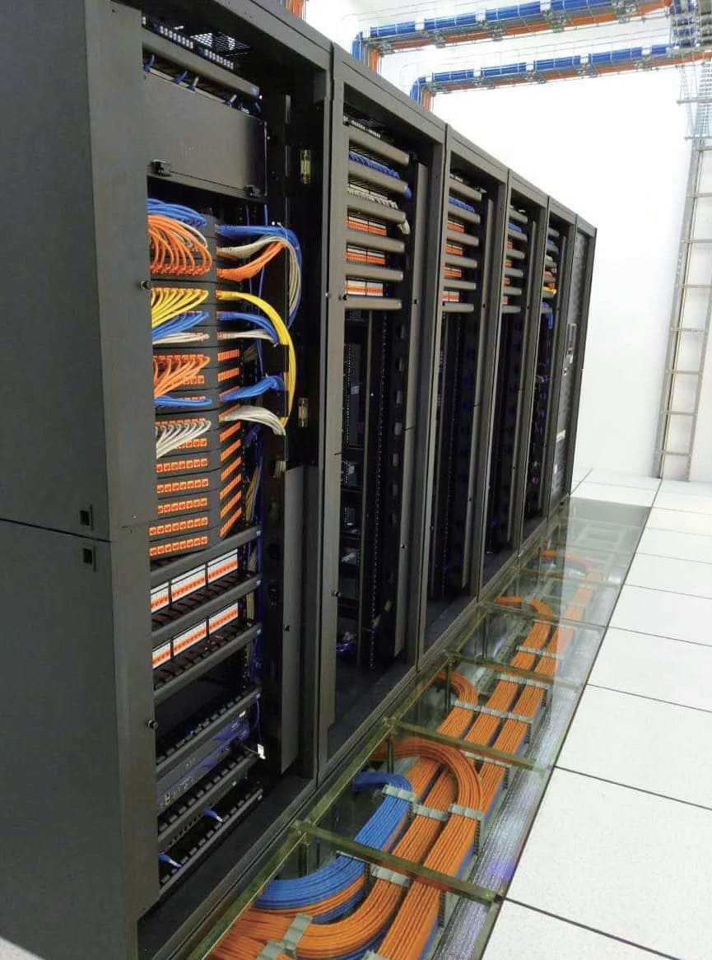
2.2 Integrated Wiring
Integrated wiring is the main business of Suzhou Fucheng under Xushi Group, which is our plant in Suzhou.
We provide advanced building intelligent integrated wiring technology and product development, production, sales and services, and provide customers with end-to-end integrated wiring solutions for voice, data and image systems integration, including: copper cable wiring solutions, data center solutions, IP network audio and video broadcasting solutions, etc.,

Slide 19
03
PART THREE
Oversea Strategy
3.1 Focus on North America High-end market

Slide 20

3.1 Focus on North America High-end market
North America is the world largest market for High-end flouropolymer low voltage communication cables. Xushi Group has been deploying North America market since 2000.
Through our efforts in last 20 years, we have found our market segments and will focus on Improving our technology for creating more value for our US & Canada partners.

Slide 21
04
PART FOUR
Contact Us

Slide 22

4.1 Contact Us
Nantong Xushi Group
No.166 North Street, Gangzha District, Nantong City, Jiangsu Province, China
Phone:
+86 0513 87596588
E-mail:
York@anelumi.com

Slide 23
2020
Nantong Xushi Group
Thank you for your watch

